Slide 1

Predicting Diabetic Patients Health Outcomes
Authors: Rohan Khandelwal & Rupesh Sasmal
Department of Computer Science, Georgia State University
Course: Data Mining
Instructor: Prof. Jingyu Liu
Notes:
“Good afternoon everyone. My name is Rohan Khandelwal, and this is my teammate Rupesh Sasmal. Today, we are presenting our project titled predicting diabetic patients health outcomes. We will walk you through the full pipeline—from problem motivation, dataset analysis, preprocessing, model building, clustering, results, and final conclusions.”

Slide 2




Why Diabetes Prediction Matters
Diabetes is a global health crisis, affecting millions and leading to severe complications if undetected. Traditional screening often lacks personalization, missing critical opportunities for early intervention. Machine learning offers a transformative approach to identify at-risk individuals sooner and more accurately.
537M Adults Affected
Preventing Complications
Worldwide prevalence of diabetes underscores the urgency.
Early detection can significantly reduce long-term health issues.
Personalized Risk
ML for Early Diagnosis
Moving beyond generic methods to individualized risk assessment.
Leveraging AI to enhance diagnostic capabilities and stratification.
Notes:
“Diabetes is a major global health concern, affecting over 537 million people worldwide according to the World Health Organization. Undiagnosed or late-detected diabetes leads to severe complications like stroke, blindness, and kidney failure.
However, traditional screening approaches are often generic and lack personalization.
Our goal was to explore how machine learning can assist in early and more accurate diabetes risk identification, enabling better preventive care and medical resource management.”

Slide 3

Project Objectives: Research Goals
Our project aims to harness the power of data mining and machine learning to improve diabetes prediction. We seek to understand the underlying medical factors, build robust predictive models, and uncover natural groupings within patient data.
Feature Analysis
Analyze key medical features and their correlation with diabetes outcomes.
Model Training
Develop and train classification models for accurate diabetes prediction.
Clustering
Apply unsupervised learning to identify distinct diabetes risk groups.
Performance Comparison
Evaluate and compare models to determine the most effective approach.
Notes:
“The primary objective of our project was to apply machine learning and data mining methods to predict diabetes outcomes and to analyze the medical features contributing to these predictions. Specifically, we focused on:
Understanding feature relationships,
Building and evaluating classification models,
Using clustering to identify natural patient risk groups,
And finally, comparing performance to determine the best predictive approach.”

Slide 4

Dataset Overview & Preprocessing
We utilized the PIMA Indian Diabetes dataset, a foundational resource in diabetes research. Rigorous preprocessing steps were crucial to prepare the data for accurate model training and analysis.
Dataset: PIMA Indian Diabetes (768 records)
Features: 9 clinical features + outcome variable
Class Imbalance: 65.1% Non-Diabetic, 34.9% Diabetic
Preprocessing Steps:
Zero placeholders for vital metrics (e.g., Blood Pressure, BMI) were intelligently replaced with median values to prevent data loss and maintain statistical integrity.
MinMax scaling normalized feature ranges, ensuring all variables contributed equally to the models and preventing features with larger values from dominating the learning process.
An 80/20 train-test split (614 training samples / 154 testing samples) was applied to evaluate model generalization effectively.
Notes:
“We used the PIMA Indian Diabetes dataset, containing 768 patient records and 9 clinical features such as Glucose level, BMI, Blood Pressure, Age, Insulin, and number of Pregnancies.
One challenge we encountered was that several features contained zeros representing missing values. To address this, we replaced those zeros with median values, which preserved statistical distribution and prevented bias.
We then applied MinMax scaling to normalize all features, ensuring equal numeric influence during model training. Finally, we performed an 80/20 train-test split to evaluate performance fairly.”

Slide 5
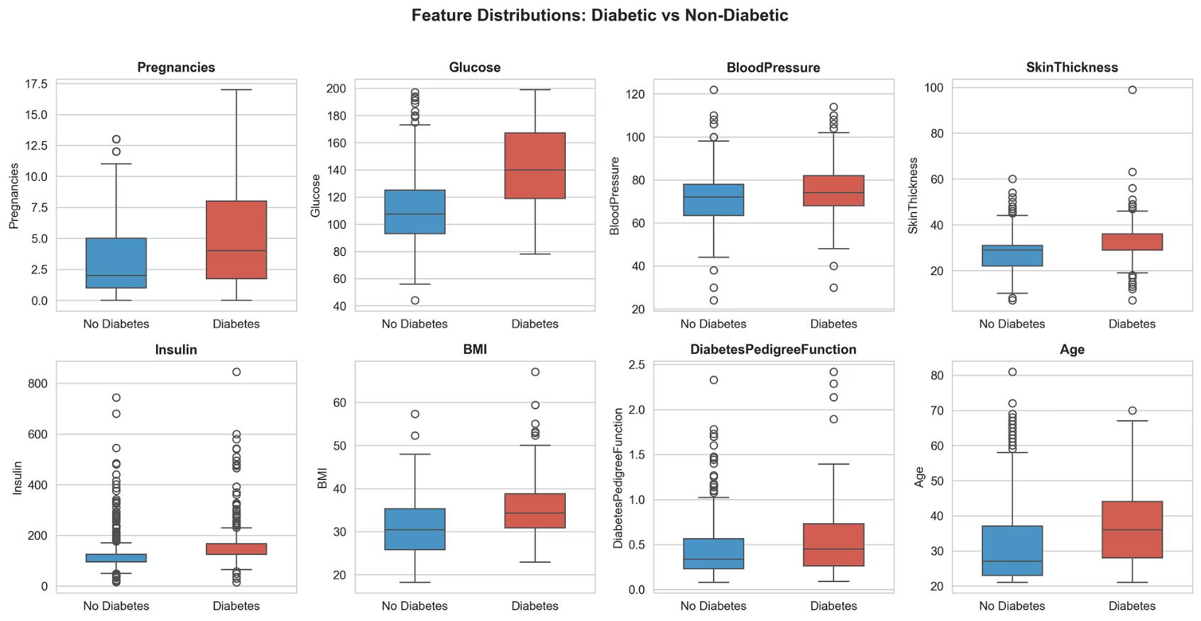
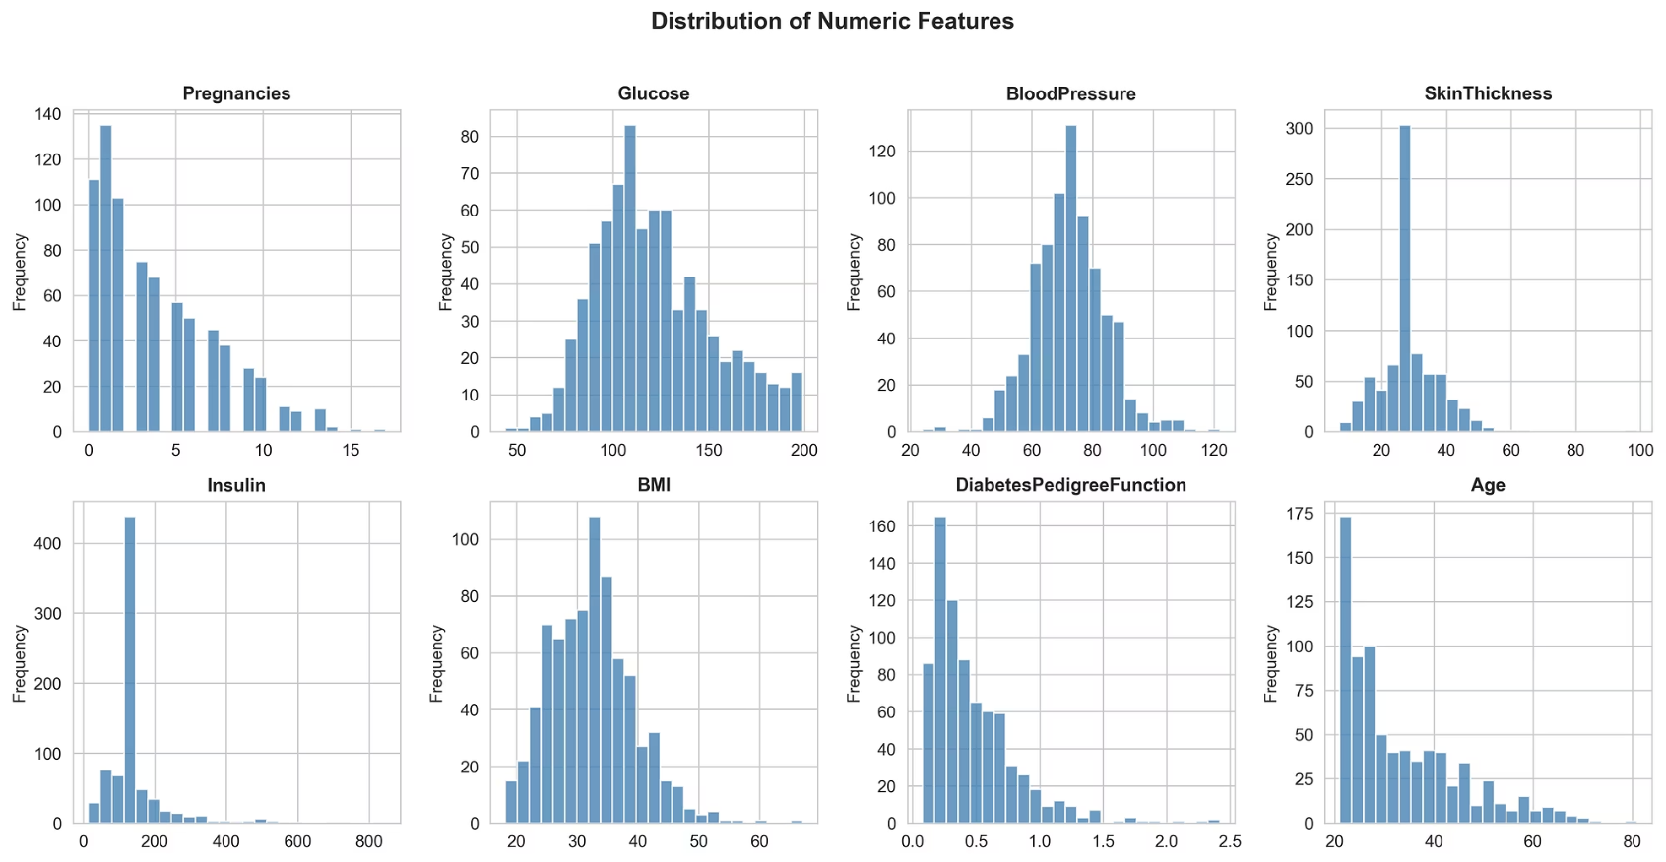
Exploratory Data Analysis: Uncovering Key Insights
Through visual analysis of histograms and boxplots, we identified crucial patterns within the PIMA dataset, highlighting features strongly associated with diabetes presence.
Key Insights:
Glucose & BMI: Significantly higher values in individuals with positive diabetes outcomes, indicating their strong predictive power.
Insulin & Pedigree Function: Exhibited high skewness, suggesting non-normal distributions that might require specific handling in modeling.
Age & Pregnancies: A noticeable correlation between age and the number of pregnancies, reflecting demographic patterns within the PIMA population.
Notes:
“Our exploratory analysis helped identify important patterns. We observed that glucose and BMI values were significantly higher for patients with diabetes, which suggests strong predictive potential. Additionally, Insulin and Diabetes Pedigree Function were highly skewed, indicating that careful preprocessing is important. We also found that age correlates with pregnancies, showing demographic structure in the dataset.”

Slide 6

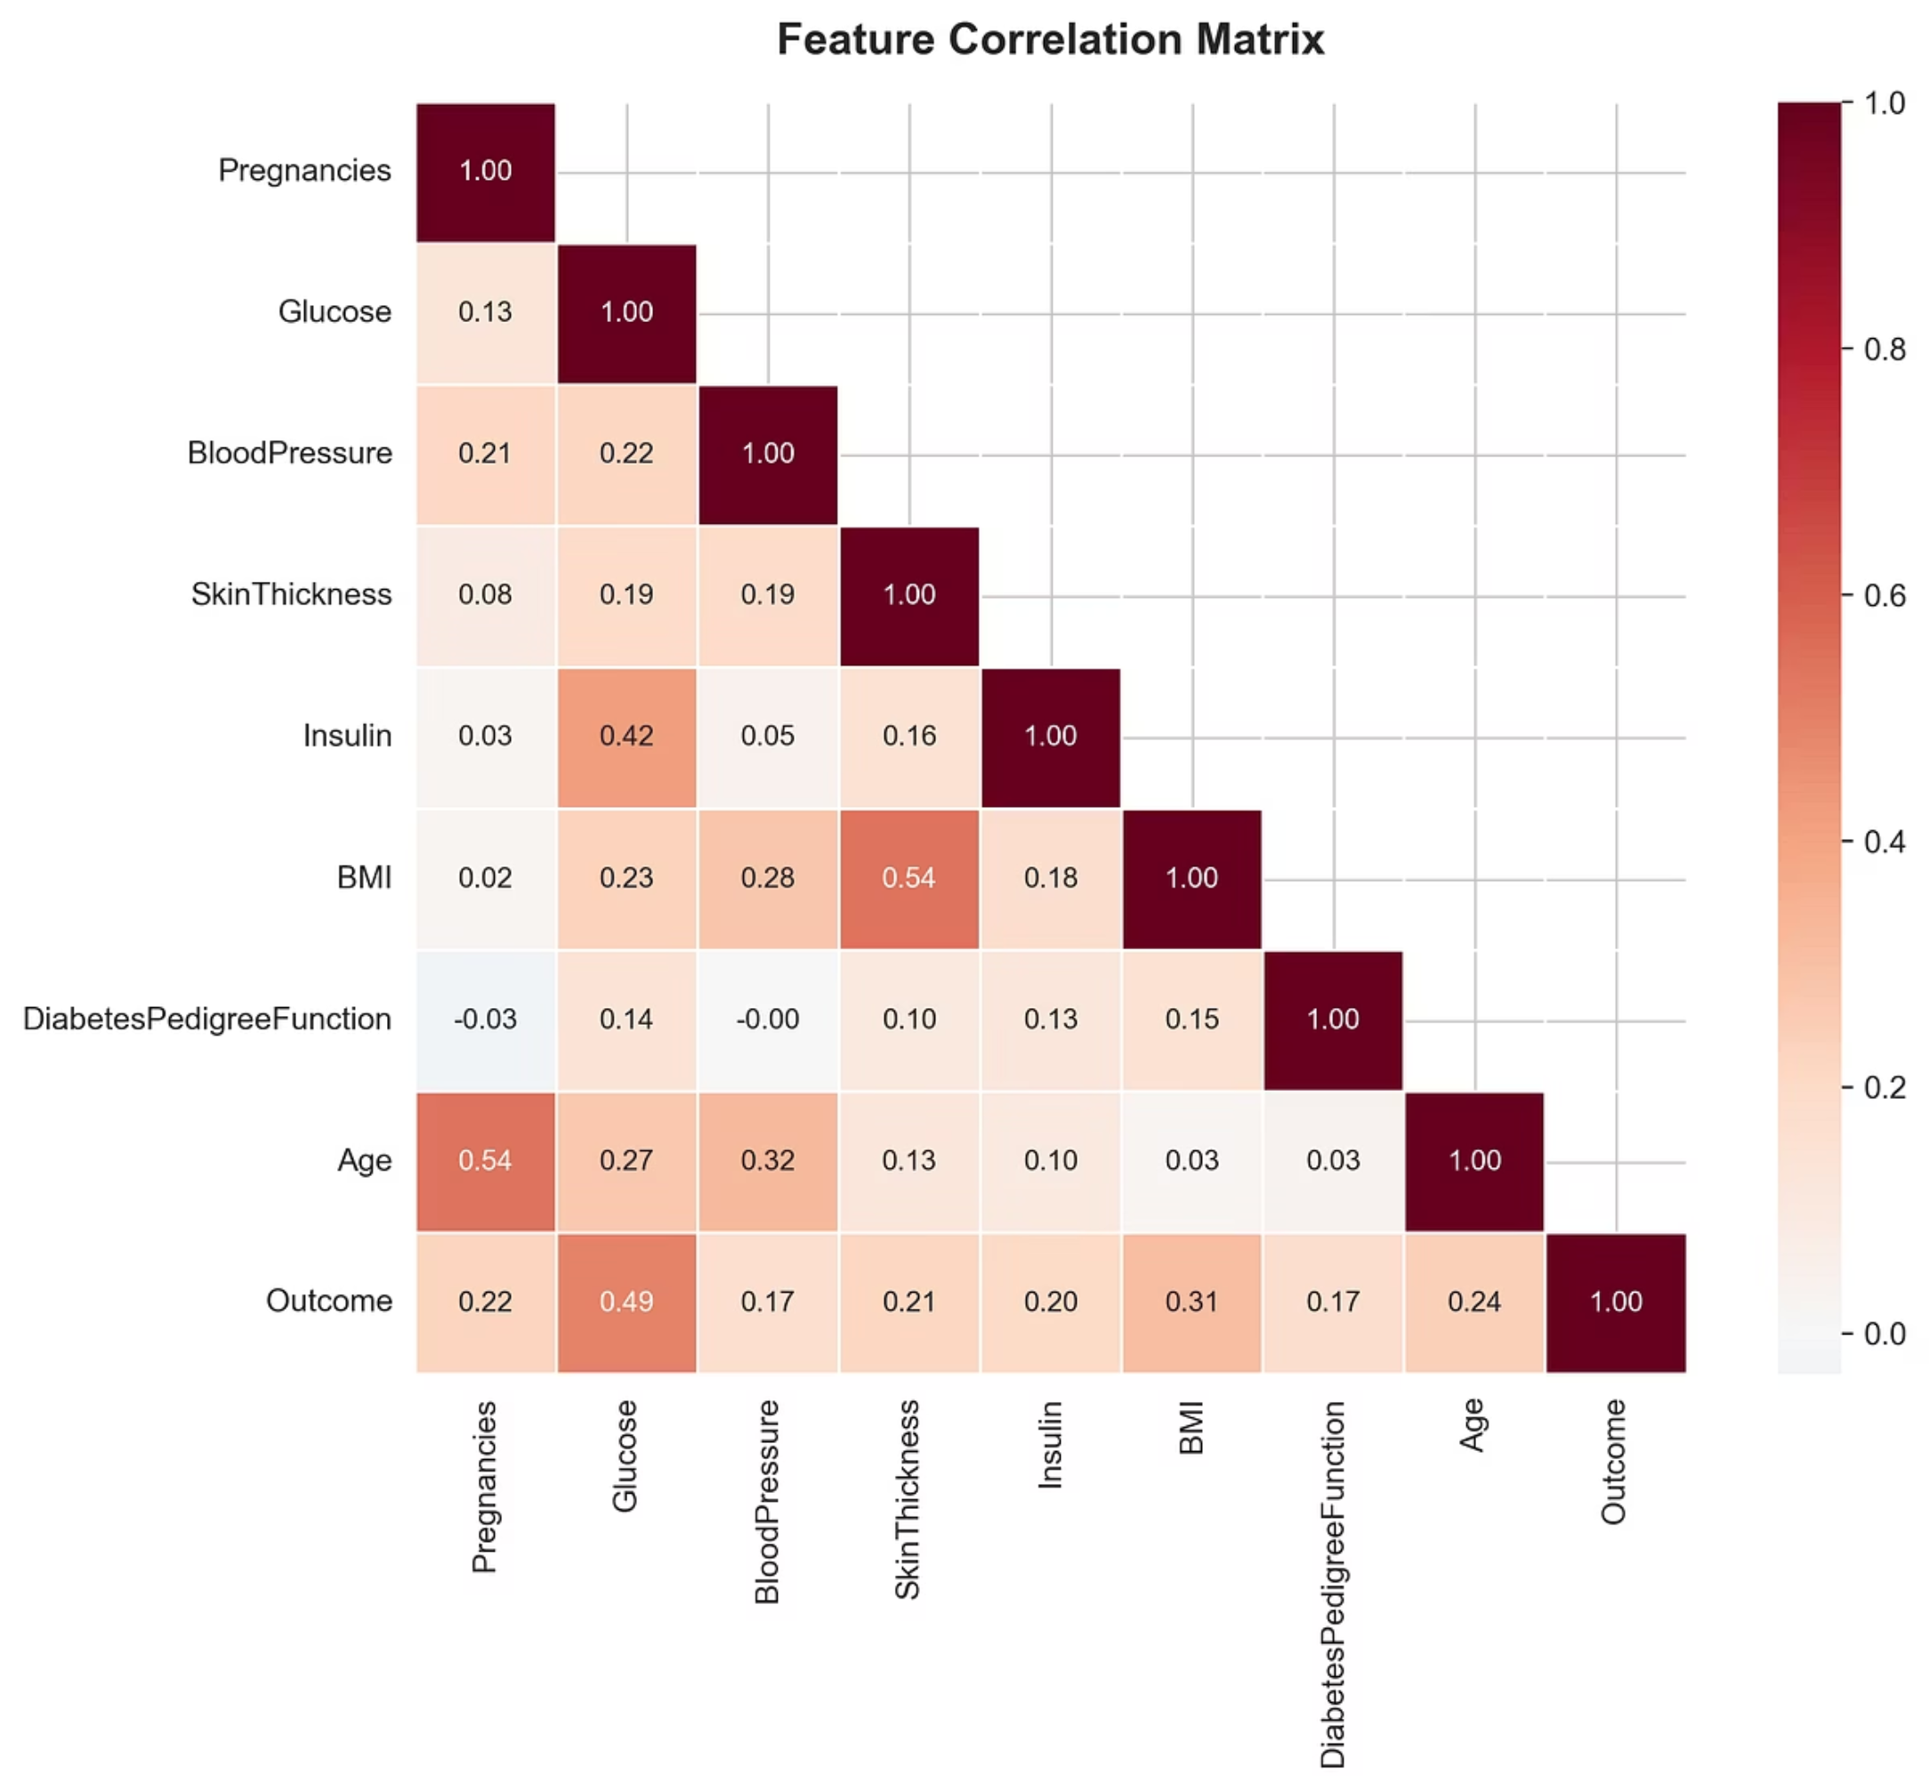
Feature Correlation Analysis
A correlation heatmap vividly illustrates the relationships between different clinical features and the diabetes outcome, guiding our understanding of feature importance.
Glucose emerged as the most strongly correlated feature with diabetes outcome, underscoring its primary role in diagnostic assessment.
BMI (Body Mass Index) and Age also demonstrated significant positive correlations, reinforcing their established importance as contributing factors to diabetes risk.
Notes:
“Using a correlation heatmap, we analyzed the relationships between features and the target outcome.
The strongest positive correlation was between Glucose and Outcome, which aligns with medical research that blood glucose level is the primary diagnostic indicator for diabetes.
BMI and Age also demonstrated significant positive correlation, reinforcing known clinical risk factors.”

Slide 7
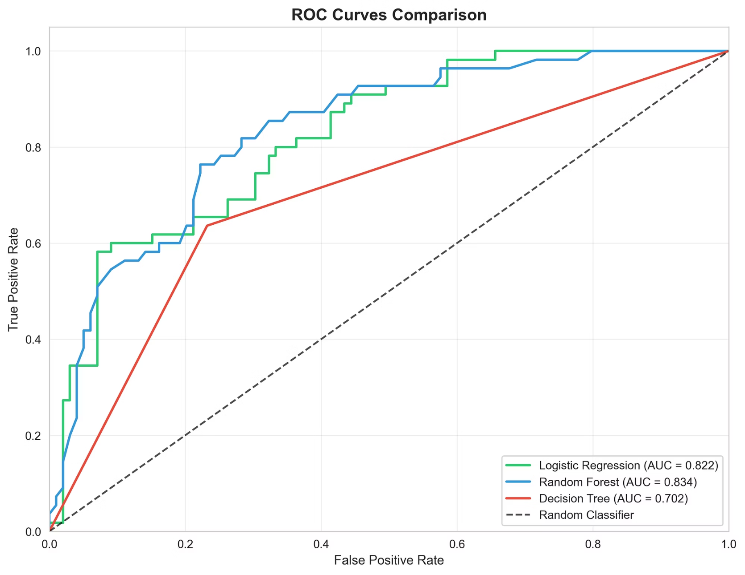
Model Training & Evaluation: Predictive Performance
We trained and evaluated several classification models, assessing their ability to predict diabetes outcomes based on F1-Score and ROC-AUC metrics. The ROC Curve visually represents the trade-off between true positive rate and false positive rate.
Logistic Regression
0.66
0.83
Random Forest
0.61
0.79
Decision Tree
0.55
0.71
Best Model: Logistic Regression
Logistic Regression outperformed other models, primarily due to the linear separability of the dataset's features related to diabetes, making it a robust choice for clinical prediction.
Notes:
“We trained three classification models: Logistic Regression, Random Forest, and Decision Tree.
We evaluated them using metrics such as Accuracy, Precision, Recall, F1-Score, and ROC-AUC.
Our results showed that Logistic Regression performed the best, achieving an F1-score of 0.66 and ROC-AUC of 0.83.
This means the dataset is largely linearly separable, and simpler interpretable models can perform very effectively.
In real medical environments, interpretability is crucial, making Logistic Regression a strong choice.”

Slide 8
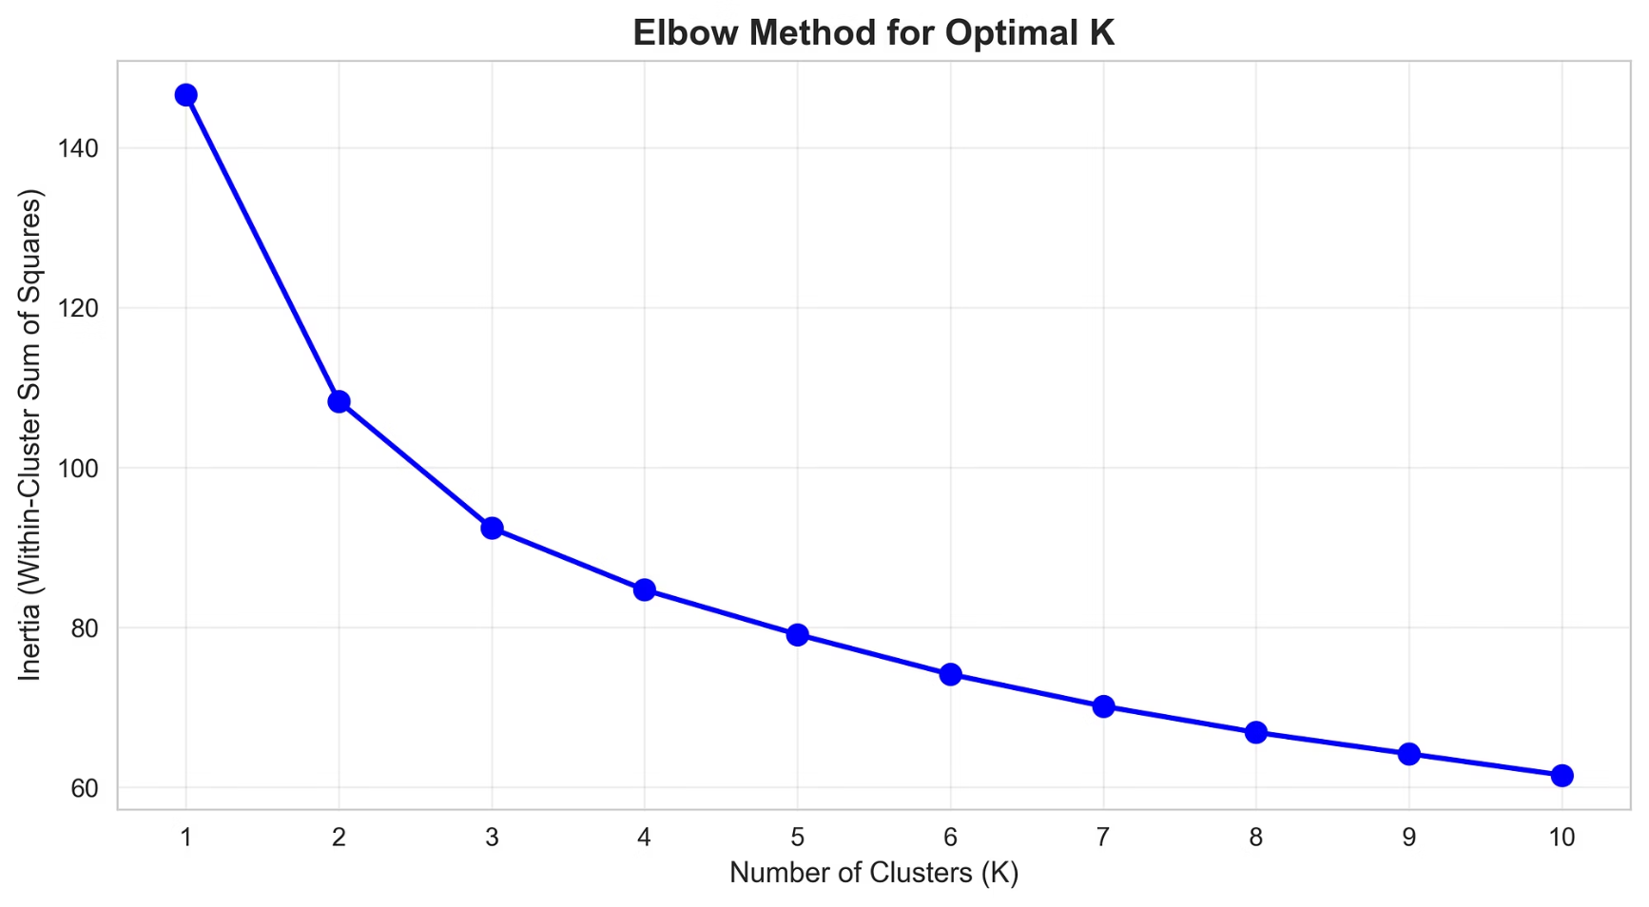
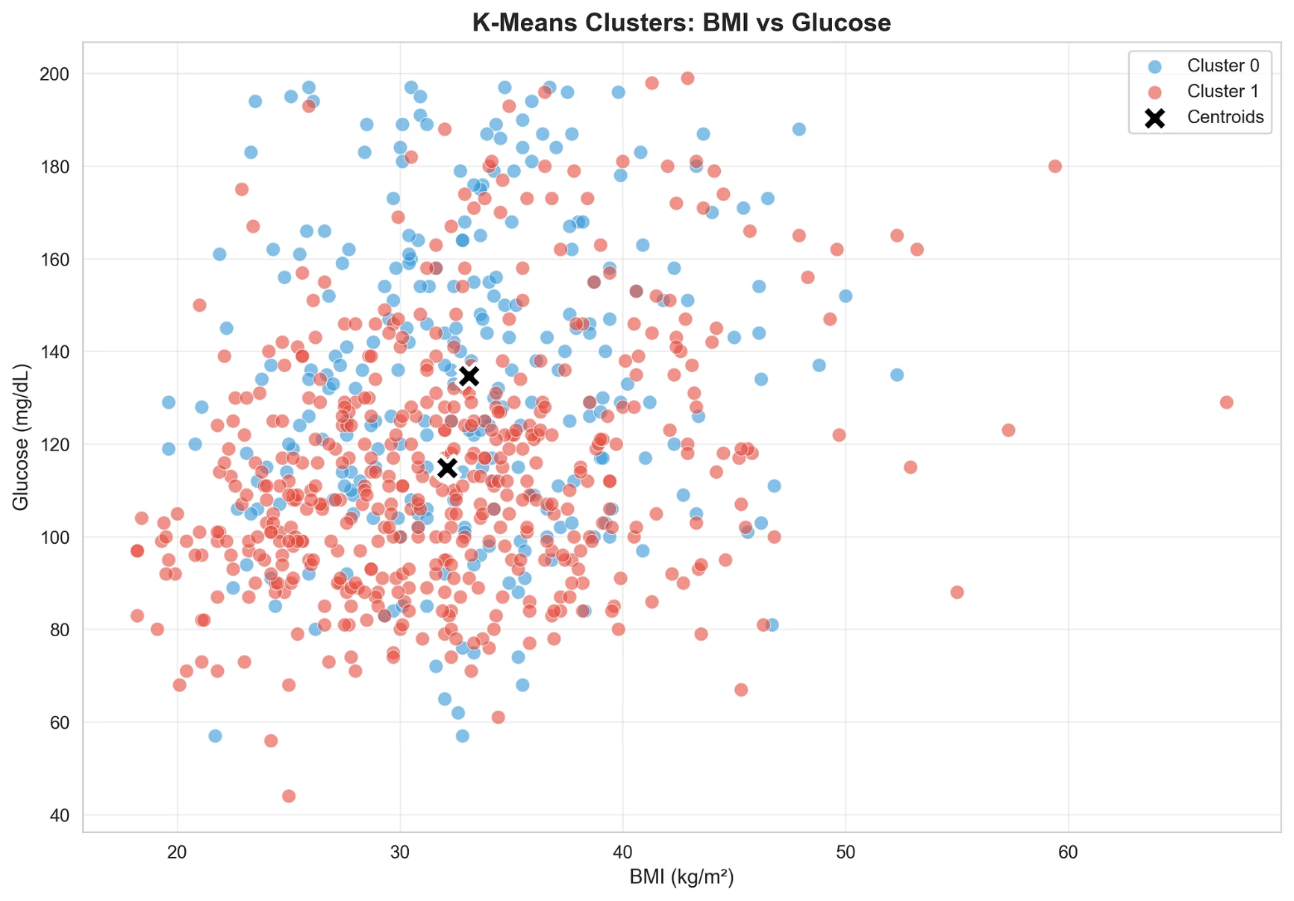
Clustering (Unsupervised Learning): Discovering Patient Sub-Populations
Unsupervised clustering revealed inherent groupings within the patient data, offering valuable insights into different diabetes risk profiles. The Elbow Method determined the optimal number of clusters.
Optimal Cluster Size: K=2
The Elbow Method, a widely-used technique for determining optimal cluster count, plots the within-cluster sum of squares (WCSS) against the number of clusters. The resulting curve exhibits a characteristic 'elbow' point where the rate of WCSS decrease significantly diminishes. In our analysis, this elbow point clearly manifested at K=2, indicating that two clusters provided the most meaningful separation of the data while minimizing information loss and avoiding over-segmentation.
Identified Risk Clusters:
High-Risk Cluster: Showed a significant diabetes rate of 54%, identifying individuals requiring closer monitoring and early intervention.
Low-Risk Cluster: Exhibited a diabetes rate of 25%, representing a population with lower immediate concern but still needing awareness.
Notes:
“We also applied K-Means clustering to explore natural groupings without using the outcome label. Using the Elbow Method, we determined the optimal cluster count to be K=2. Cluster analysis revealed:
A high-risk cluster with a 54% diabetes rate, characterized by high glucose and BMI levels,
And a low-risk cluster with a 25% diabetes rate. This insight can help hospitals and clinics prioritize screening and allocate preventive resources efficiently.”

Slide 9

Conclusions & Future Work
Key Conclusions
Machine learning models significantly enhance diabetes risk screening capabilities.
Logistic Regression proved to be the most effective model for clinical prediction, offering a balance of accuracy and interpretability.
Clustering successfully identified distinct patient sub-populations, crucial for targeted intervention strategies.
Future Enhancements
Incorporate additional clinical features, such as HbA1c levels, dietary habits, and exercise routines, for a more comprehensive predictive model.
Explore advanced algorithms like XGBoost and rigorous cross-validation techniques to further boost accuracy and model robustness.
Notes:
“To conclude, machine learning demonstrated strong potential for improving diabetes risk prediction and early detection.
Logistic Regression proved to be the most reliable and interpretable model for clinical scenarios.
Clustering revealed meaningful high-risk and low-risk patient groups, showing real-world application potential for triage and intervention planning.
Future improvements could include adding more clinical variables such as HbA1c, lifestyle factors, and testing advanced models like XGBoost for further improvement.”

Slide 10

Acknowledgment & Questions
We extend our sincere gratitude to:
Professor Jingyu Liu for invaluable guidance and support throughout the coursework.
The UCI / Kaggle Diabetes Dataset Source for providing the essential data for our project.
Thank you for your attention!
Questions?
Notes:
“We would like to sincerely thank Professor Jingyu Liu for continuous guidance, and the UCI / Kaggle dataset resource for providing data support.
Thank you for listening to our presentation. We welcome any questions you may have.”

